Slide 1
history

Slide 2

2006 - Amazon Web Services
is launched.

Slide 3

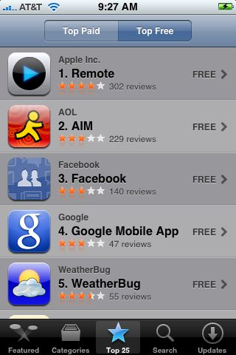
2006 - Twitter
2007 - The Hashtag
2007, June - iPhone for sale
2008, July - Apple App Store Launch

Slide 4
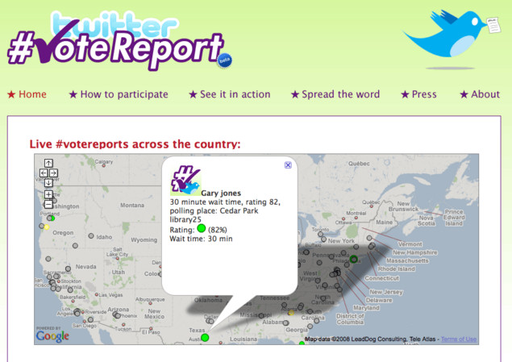
2008 - Twitter vote report.

Slide 5
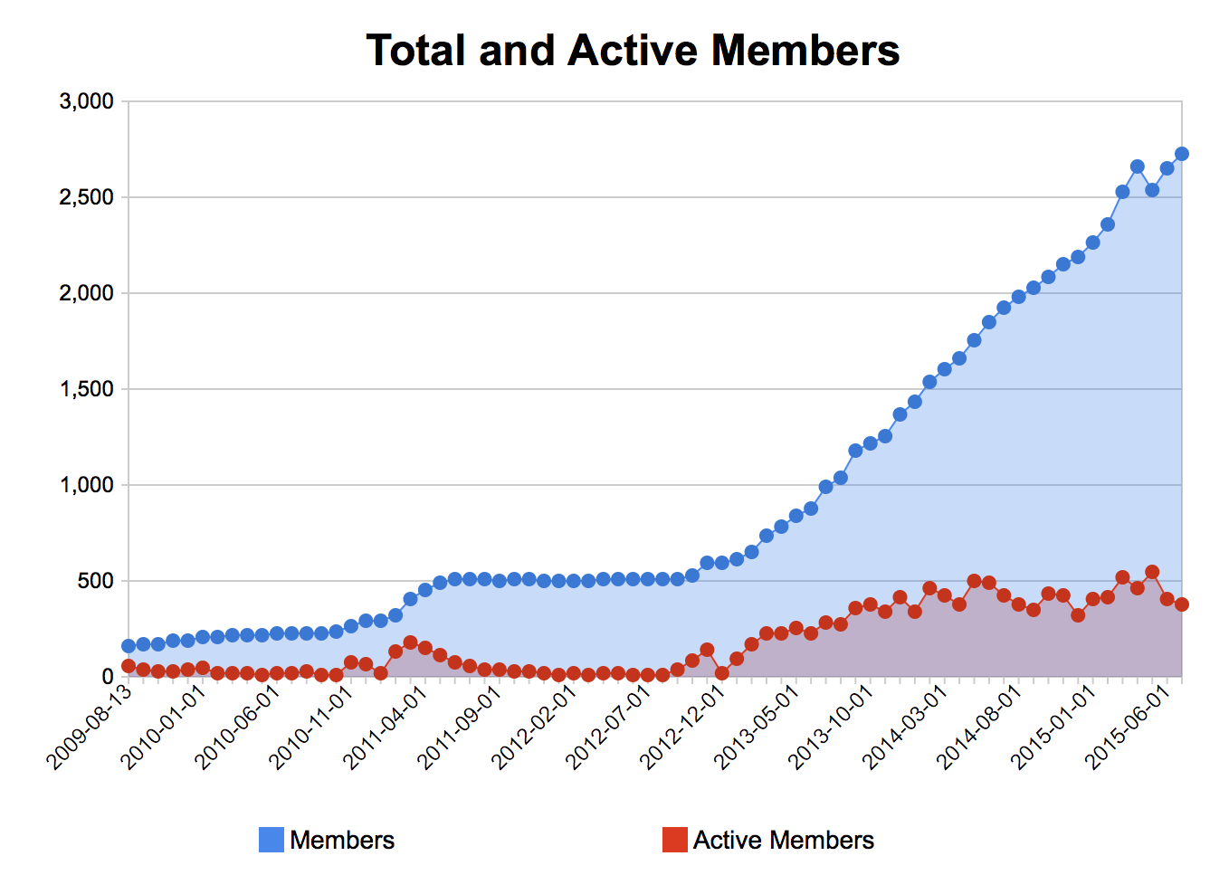
NYC Civic Hacker Growth
Total Meetup.com membership - 2,546
Average active participation - 20%
Average per month growth - 5%
(Numbers from May 2015)

Slide 6
my challenge

Slide 7
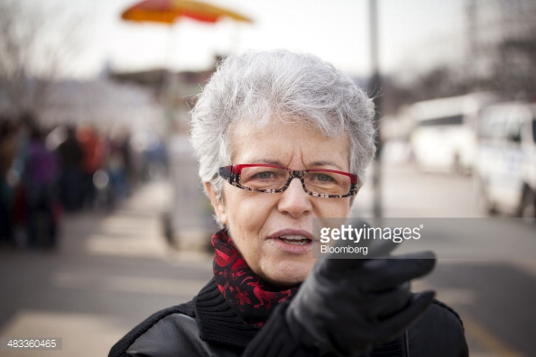
Meet a Community Board Member
Christine Berthet
Berthet told Chelsea Now that her first goal is to do “everything we can to reach out to the new members of the community, and do better outreach so that everybody’s aware of what’s going on. This is very, very important for the future of the board.”
Another top priority, said Berthet, is board’s ongoing commitment to help ensure the scope and purpose of new construction is in synch with the surrounding area.
“If the development is done in a way where we keep diversity and we keep the neighborhood character,” she said, “this is not an issue. It’s good news.” If not, “Then that is an issue.” Each new project coming before the board, she asserted, “has to be done in a certain way, to integrate with the neighborhood.”
Source: Chelsea Now, 5 Dec 2013, http://bit.ly/1J6qKSK
Manhattan Community Board 4, Chair
Neighborhood: Hell’s Kitchen
Age: 60+
Profession: Sunnyside Records, Owner; CheckPed, Organizer

Slide 8
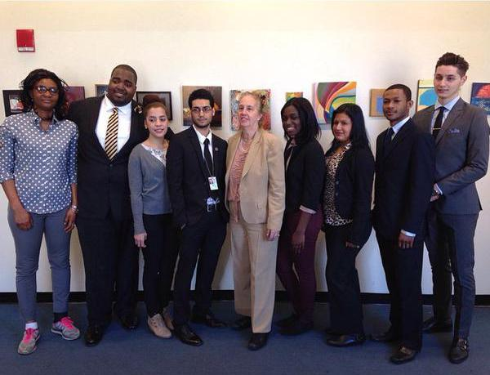
Last year’s
CUNY Service Corp Fellows
"The wealth of city data available online needs to be made usable," said Brewer. Once the students are trained, they will work with Manhattan's community boards in solving neighborhood problems…
Brewer also sees the initiative as a great way for the students involved to gain a foothold in what is an emerging industry. Tech jobs are now necessary and available in virtually every industry, and open data is projected to bring in three to five trillion dollars in economic value annually across seven sectors, according to an October 2013 study conducted by McKinsey & Company.
"My vision is that these service corps members will have the tools for a new career in civic technology," Brewer said. "I feel very proud to be able to train them in a topic that I think will be good for their careers."
Source: Gotham Gazette, 15 Sep 2014, http://bit.ly/1IICEpR
Manhattan Borough President Gale A. Brewer & 2014’s CUNY Service Interns
Source: http://bit.ly/1JKdoR2

Slide 9


Next challenge
Build a program to educate and empower a new generation of leaders.
Connect new people to the civic technology ecosystem.
Learn what problems community boards face.
Innovate classes and share best practices.
Collaborate to solve real world problems all New Yorkers face.

Slide 10
Needs
Someone to help run a 5 hour workshop on human centered design.
Design and data mentors who can help coach college students though this process.
Money

